Slide 1
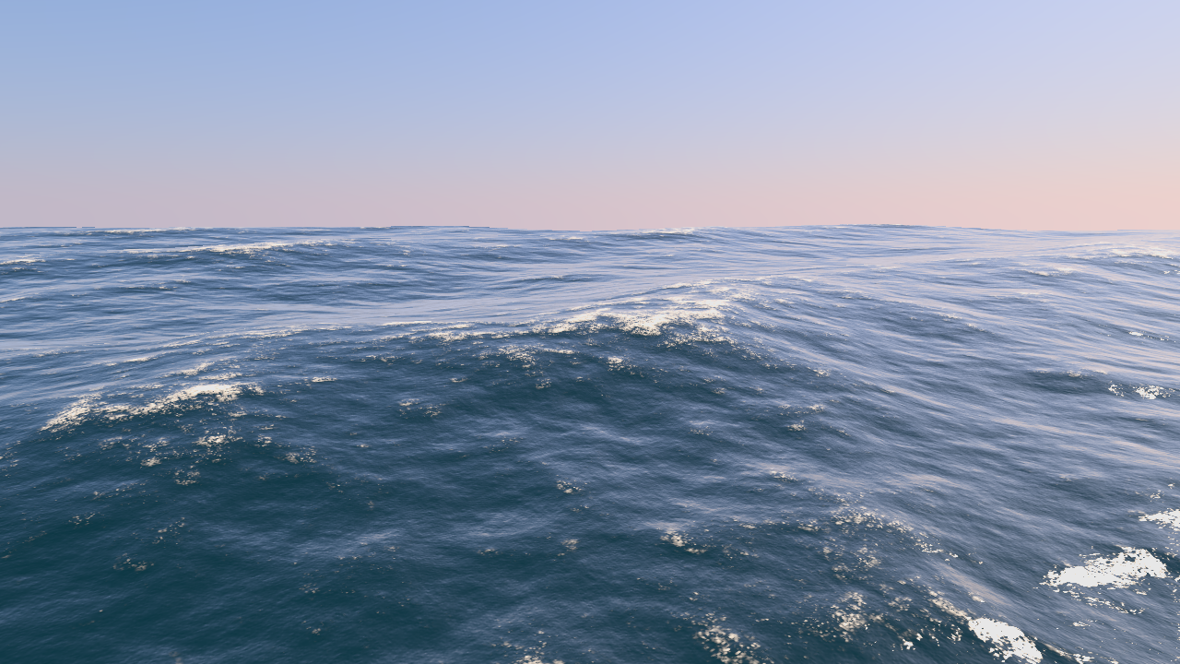
Ocean Surface Generation and Rendering
Thomas Gamper
Research Division of Computer Graphics
Institute of Visual Computing & Human-Centered Technology
TU Wien, Austria

Slide 2
Motivation
Generation, animation and rendering of the surface of an open ocean in real time.

Slide 3
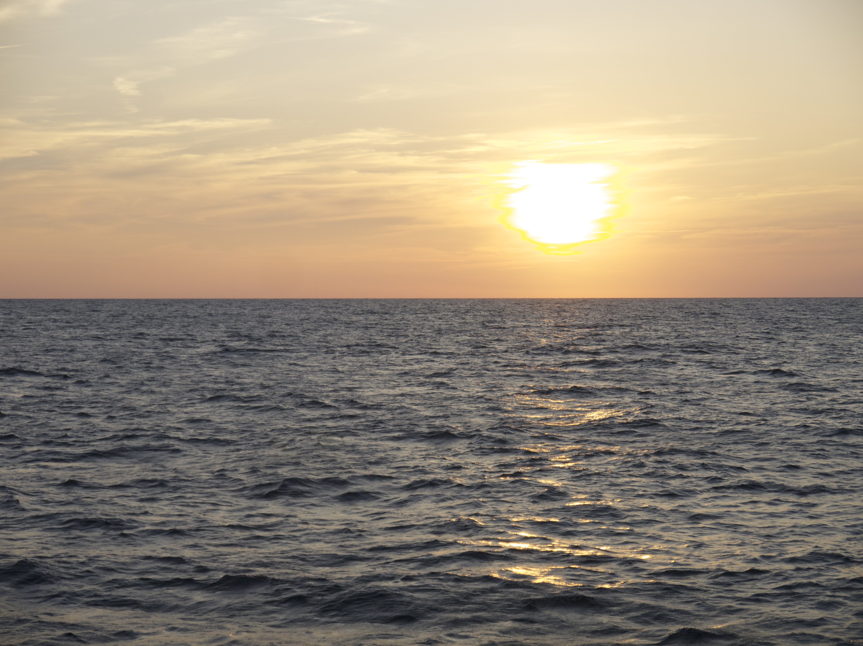
Motivation
Sunset over the ocean.

Slide 4
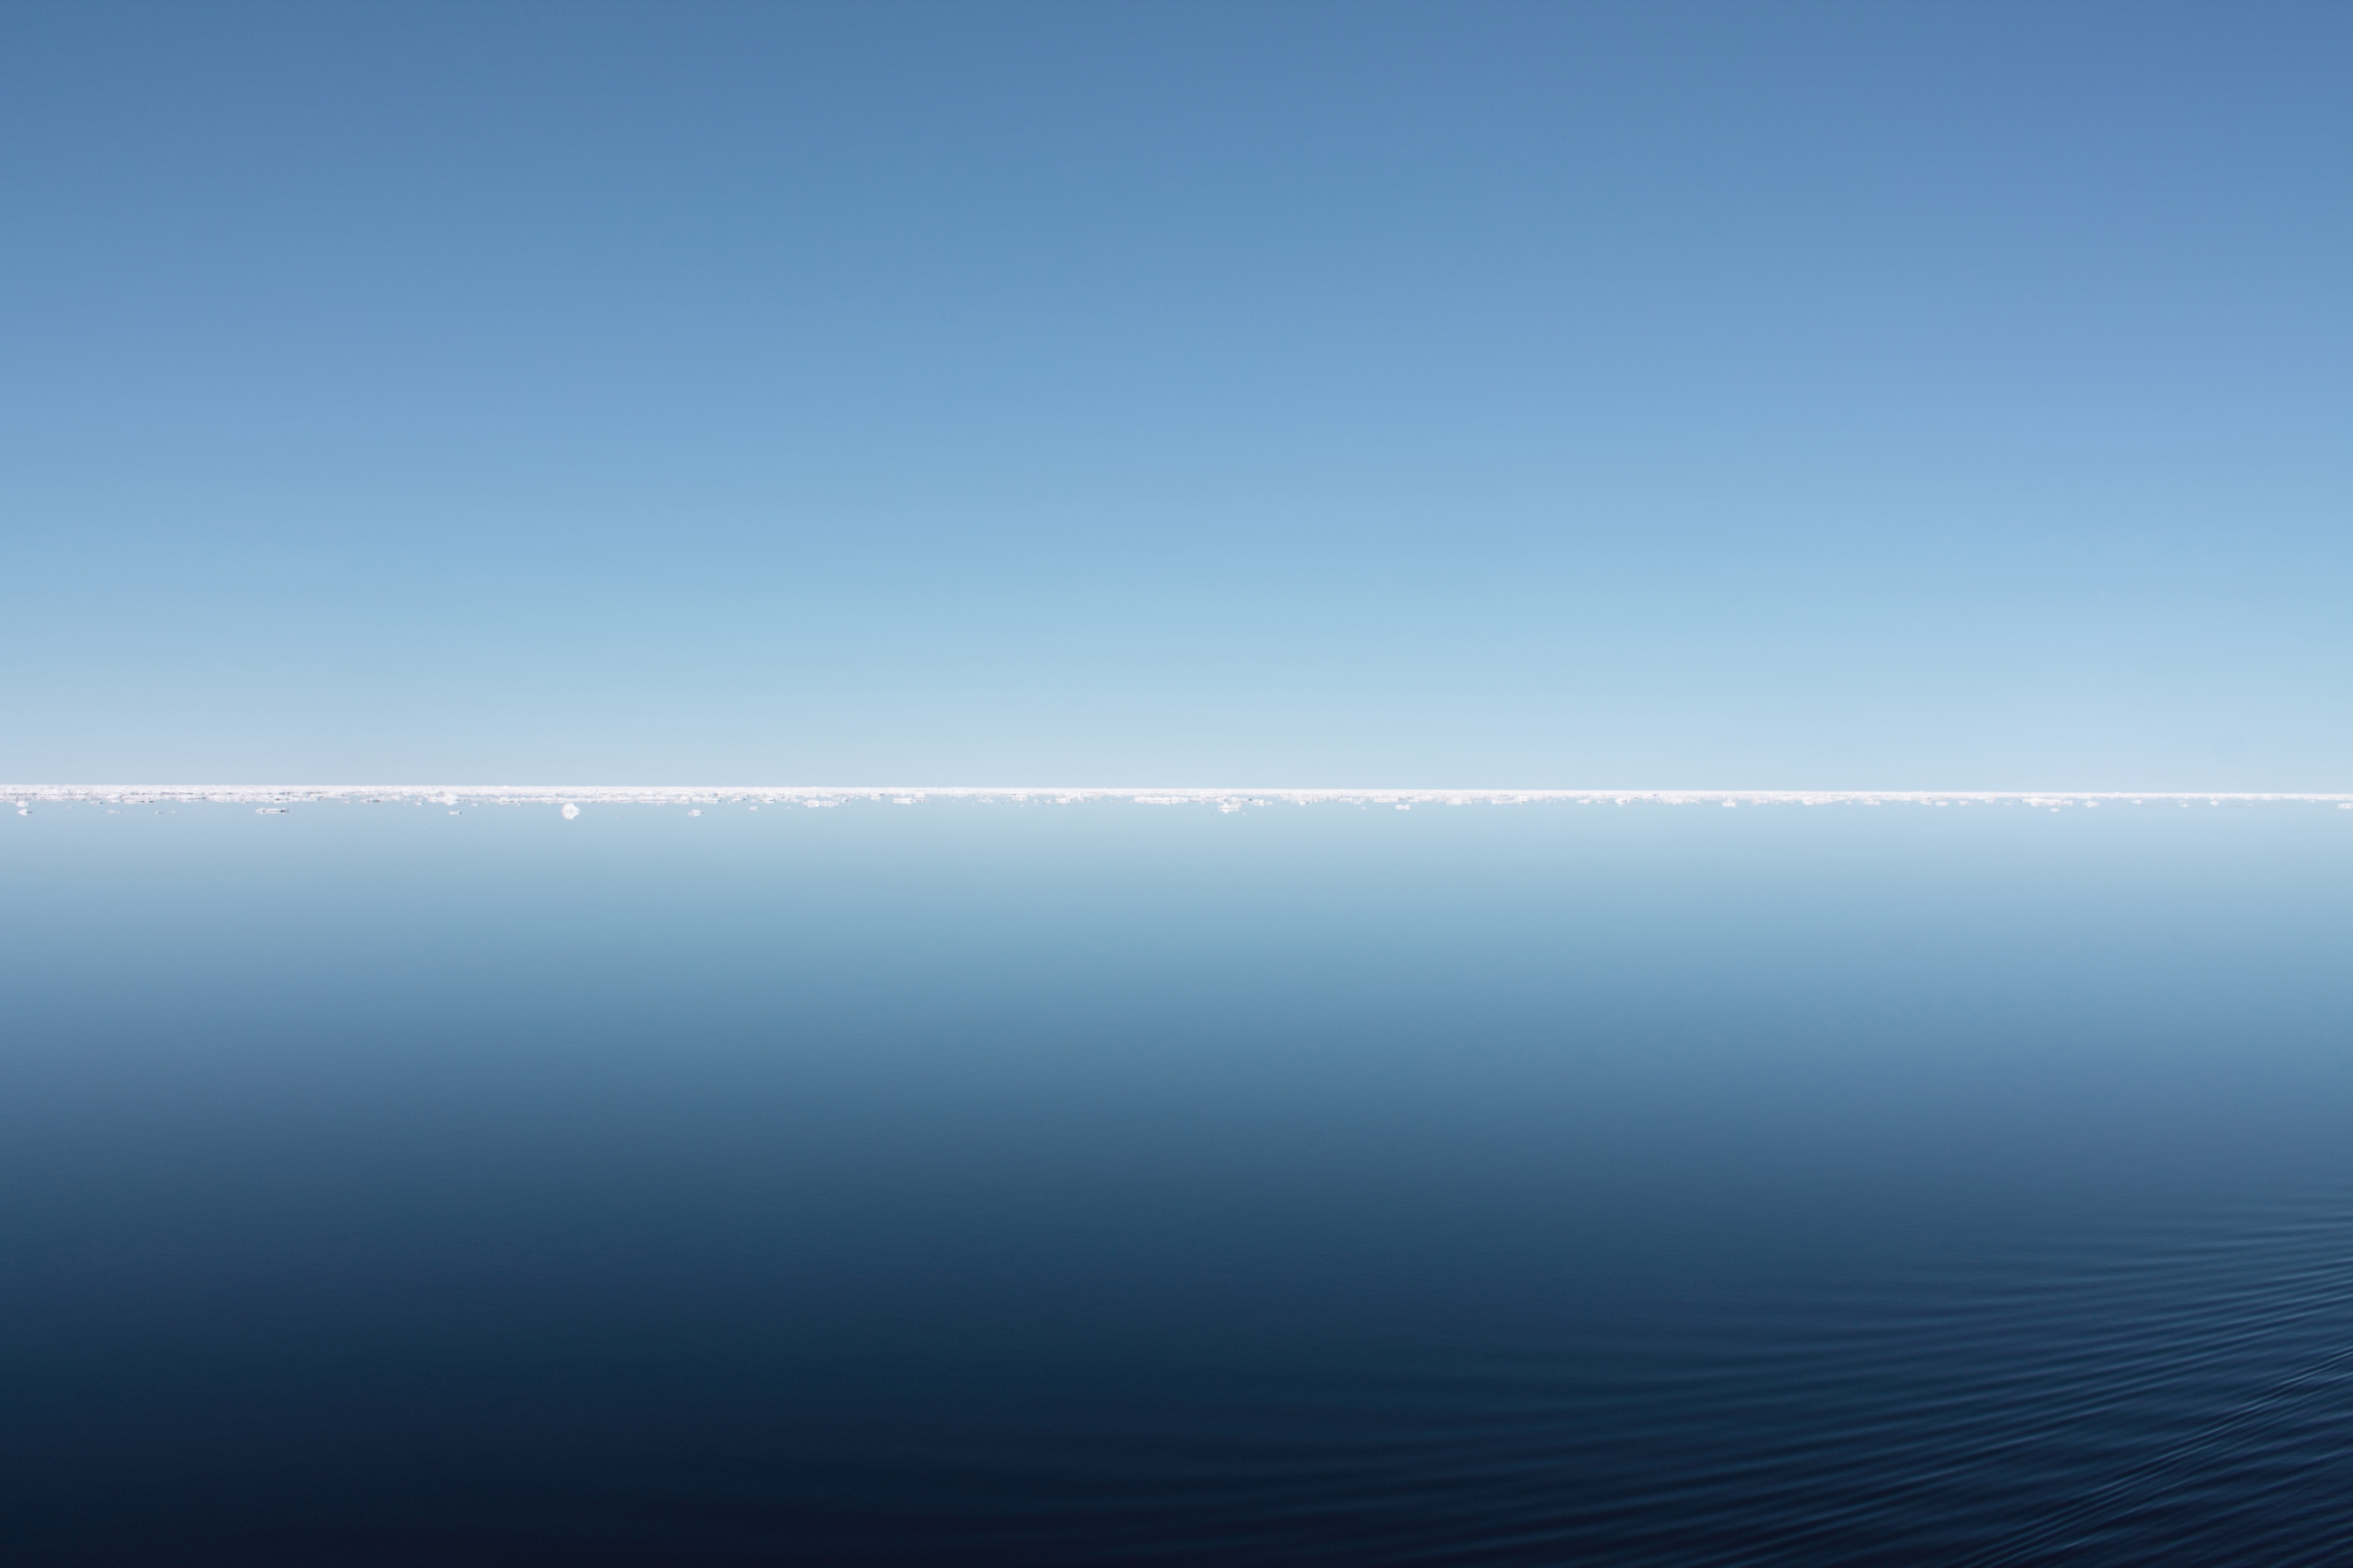
Motivation
Perfectly calm arctic sea.

Slide 5
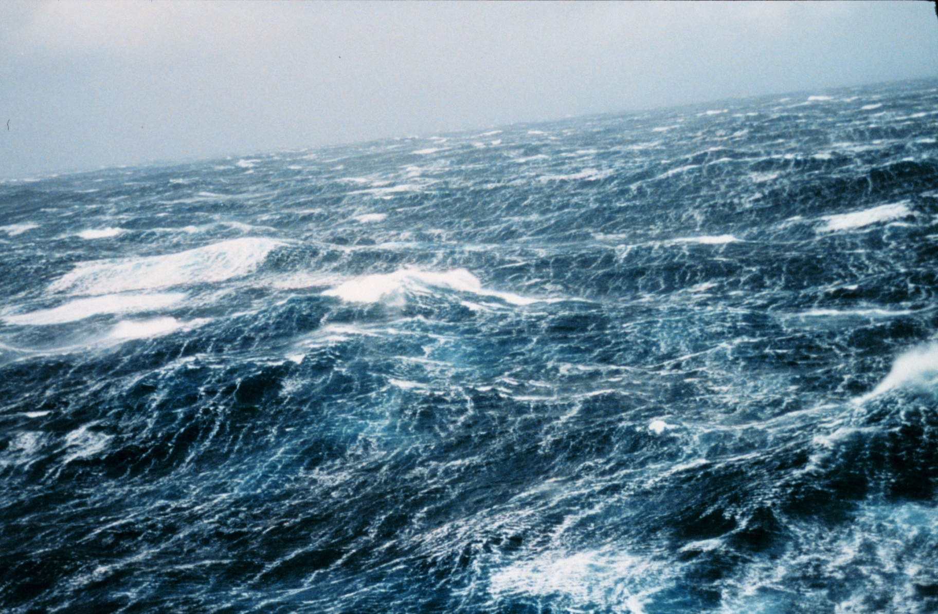
Motivation
Storm waves.

Slide 6
Motivation
Challenges in the context of real-time rendering:
Ocean is dynamic and complex
Closeups and views to the horizon
Lighting

Slide 7
Related Work
Choppy wave algorithm [Tessendorf1999]
Employs wave spectrum concept from oceanography
Adapted for real-time operation
Meshing [Johanson2004]
Lighting [Bruneton2010]
Whitecaps [Dupuy2012]

Slide 8
Problems
Choice of wave spectrum
Many distinct models
Which model fits which type of sea best?
Which models are compatible with [Bruneton2010]?
Performance
Level of detail

Slide 9
Wave spectra
From oceanography
Pierson Moskowitz
JONSWAP
Donelan
Elfouhaily
From computer graphics
Phillips

Slide 10
Pierson Moskowitz
For gentle seas
Works flawlessly with [Bruneton2010]

Slide 11
JONSWAP
For turbulent seas
Issues with [Bruneton2010] at low fetch

Slide 12
Donelan
For turbulent and semi-turbulent seas
Breaks down with [Bruneton2010]

Slide 13
Elfouhaily
Between gentle and turbulent seas
Best for closeups
Works flawlessly with [Bruneton2010]

Slide 14
Tessendorf
Disqualified

Slide 15
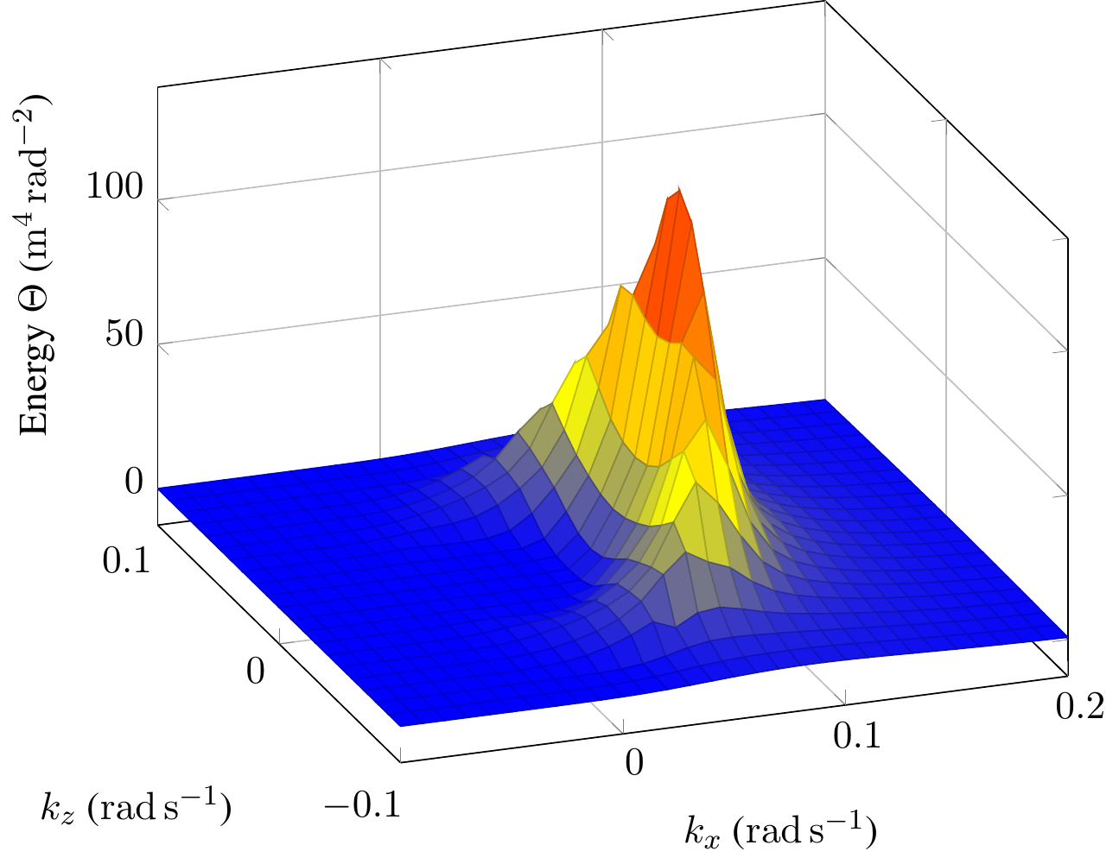
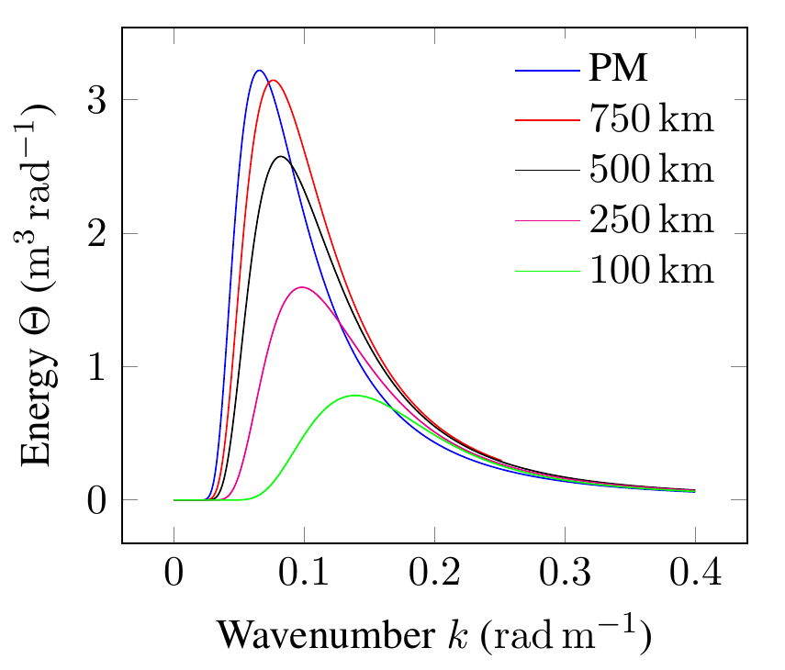

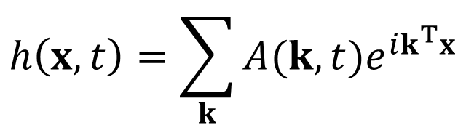
Wave spectrum
$$h\left(x,t\right)=\sum_{k}{A(k,t)e^{ik^{T}x}}$$

Slide 16
Evaluated wave spectra (1/2)
Pierson Moskowitz
Works best for gentle seas
Awesome with lighting
JONSWAP
Suitable for agitated seas
Works well with lighting, except low fetch conditions
Donelan
Suitable for all kinds of sea
Lighting is a disaster

Slide 17
Evaluated wave spectra (2/2)
Unified
For all seas between PM and JONSWAP
Good with small wavelengths -> closeups
Works flawlessly with lighting
Tessendorf
Geometry is a disaster, no further analysis

Slide 18
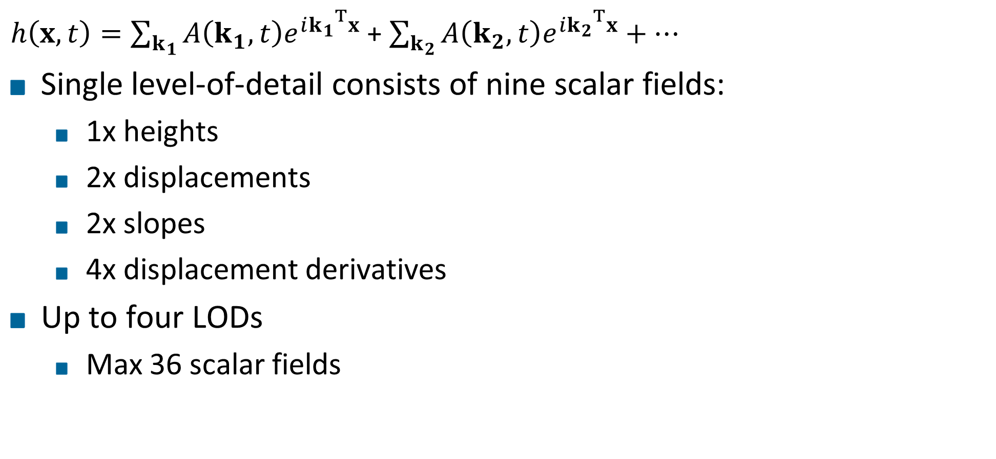
Level of detail
$h\left(x,t\right)=\sum_{k_{1}}{A\left(k_{1},t\right)e^{i{k_{1}}^{T}x}}$ + $\sum_{k_{2}}{A\left(k_{2},t\right)e^{i{k_{2}}^{T}x}}+…$
Single level-of-detail consists of nine scalar fields:
1x heights
2x displacements
2x slopes
4x displacement derivatives
Up to four LODs
Max 36 scalar fields

Slide 19
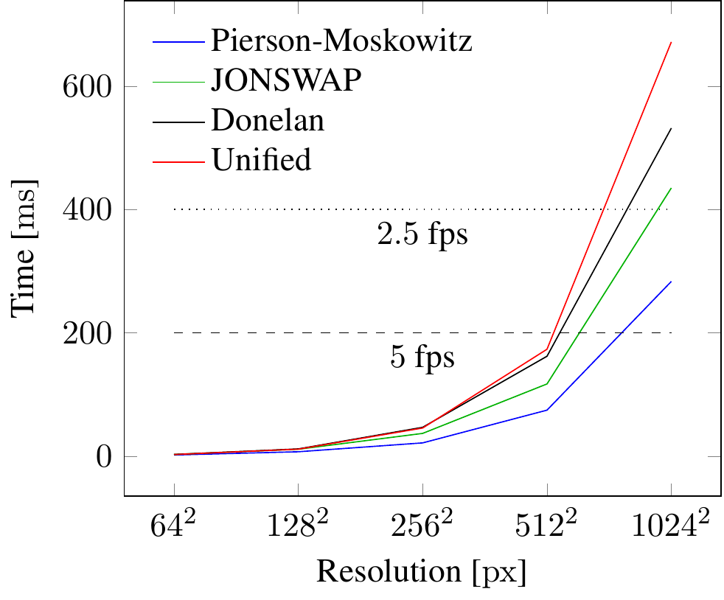
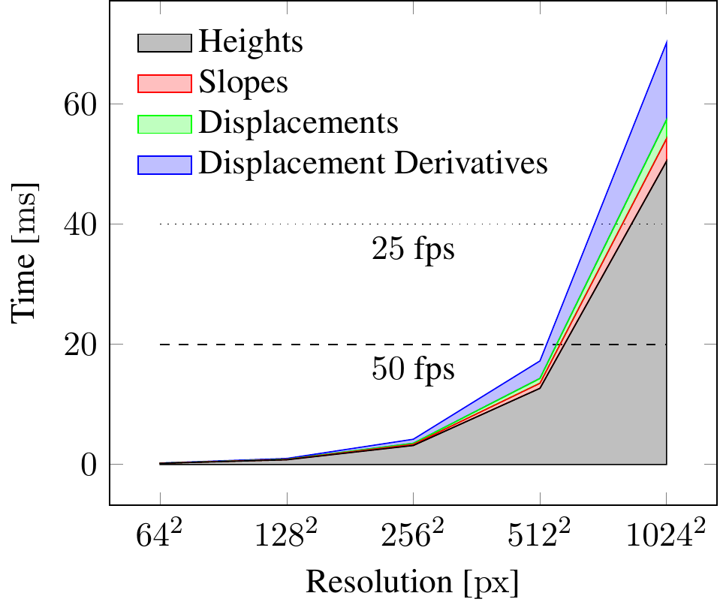
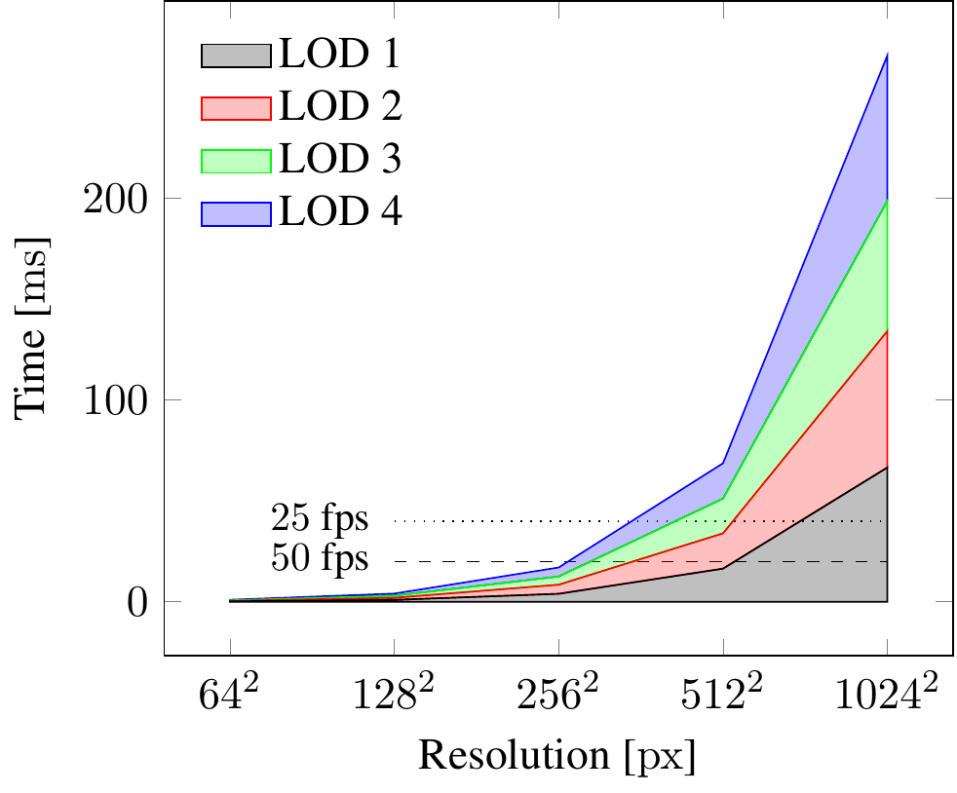
Performance LOD generation

Slide 20
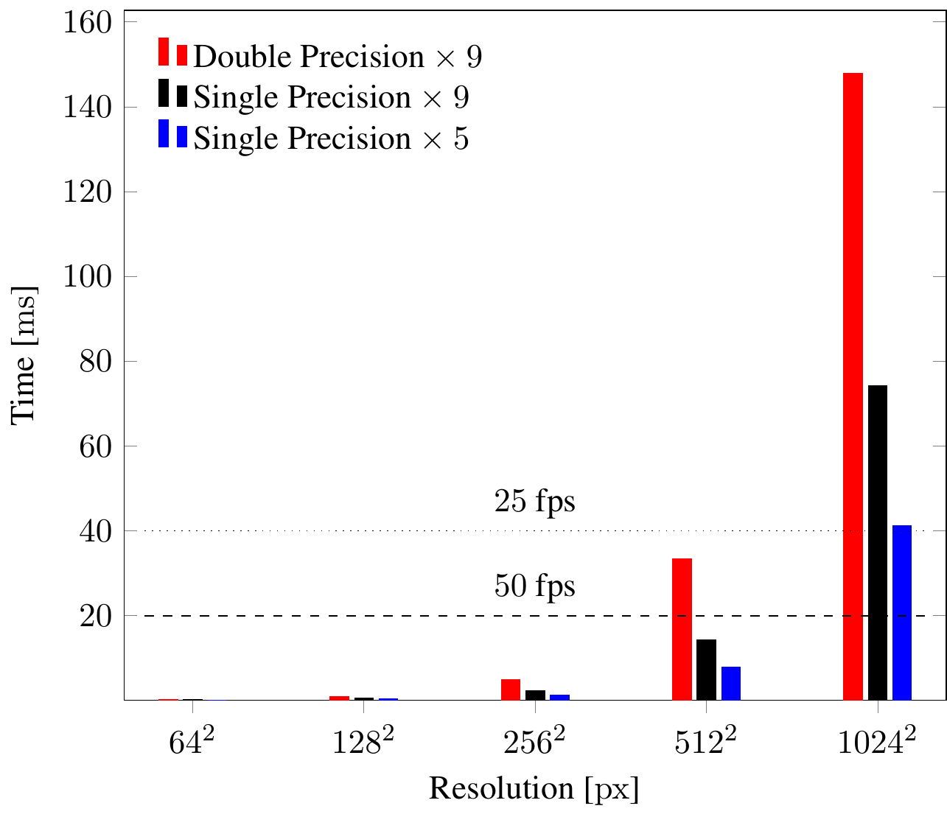
Performance FFT
Pack nine scalar fields into 5

Slide 21
Multi-Res
Support two distinct resolutions
Heights and displacements
Slopes and displacement derivatives
Only up to 10% gain for generation
Speedup in FFT up to 40% because low-res FFT basically negligible
Further improvements down the line because less data to transfer and to process

Slide 22
Video

Slide 23
Summary
Contribution 1: implement and evaluate wave energy models
Pierson-Moskowitz and Unified work well in all conditions
JONSWAP works well in most conditions, except low-fetch
Donelan and Tessendorf disqualified
Contribution 2: multi-resolution level-of-detail
Allows for more fine-grained balance between model detail and performance

Slide 24
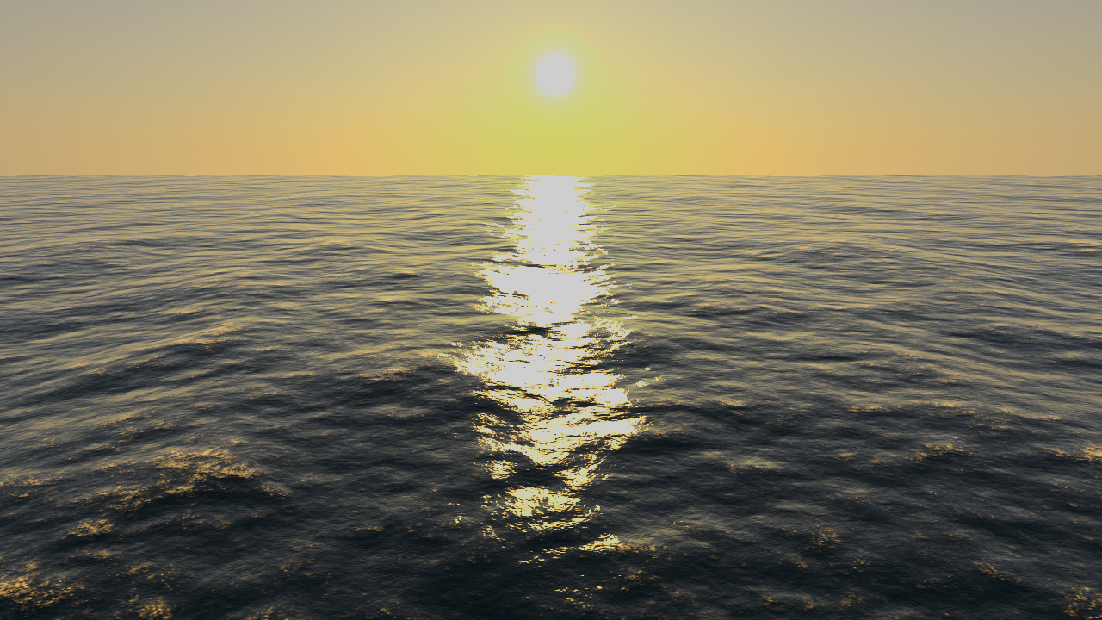
Thank You for your Attention!

Slide 25
Future Work

Slide 26
Headline
Level 0
Level 1
Level 2
Hint: Do NOT use bullet lists wherever possible !!!

Slide 28
Sometimes a dark background is better. Use this template.

Slide 29
Thank You for your Attention!
Don't forget to include a last slide that contains teaser images or a video or something else that reminds people about what you said.
It might well be that this slide will be on the screen during the whole discussion!

